Slide 1
Consumer Insights: Wireless Speaker Market
Final Analysis and Strategic Recommendations
Prepared for Beats by Dre | May 2025

Slide 2
Executive Summary & Key Recommendation
Vision
To redefine premium audio by merging style, innovation, and cultural relevance — making Beats by Dre the leading choice for immersive and expressive sound experiences globally.
Mission
To deliver high-fidelity wireless speakers that not only meet but exceed user expectations in sound quality, portability, and design — leveraging data-driven insights and user sentiment to guide every decision.
Goal
To evaluate market sentiment, consumer preferences, and competitive benchmarks in order to inform a successful launch strategy for a new Beats by Dre wireless speaker. This includes:
Identifying key features consumers value most.
Strategy
Understanding preferred price points and sales channels.
Uncovering pain points from competitor reviews to shape product improvements.
Strong customer preference for high sound quality and durability.
Providing actionable recommendations to position Beats as a market leader.
Sentiment analysis shows Beats underperforms in battery life.
Customers associate JBL with portability and Sony with bass depth.
Recommendation: Launch a premium wireless speaker with improved battery life and durability.

Slide 3
Research Overview
Quantitative & Qualitative Survey Analysis:
Analyzed the first 20 responses from a wireless speaker consumer survey
Extracted insights from both multiple-choice and open-ended responses
Review-Based EDA & Sentiment Analysis:
Performed exploratory data analysis on Amazon wireless speaker reviews (~5,000 entries)
Used TextBlob for sentiment scoring and Gemini AI for feature-based sentiment breakdown
Tools: Google Sheets/Excel, Python, Pandas, Seaborn, TextBlob, WordCloud, Gemini AI

Slide 4
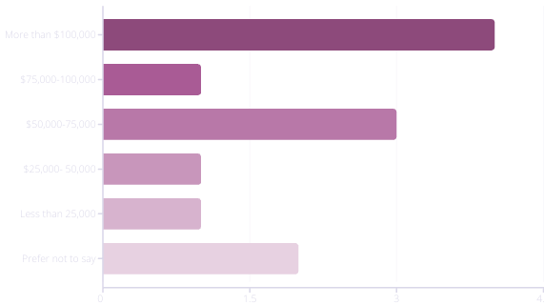
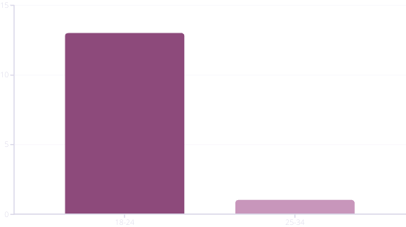
Target Audience Profile
70% of respondents are under 35 (Gen Z + Millennials)
60% earn under $60K — price-sensitive
Use speakers daily/weekly for music and fitness
Prioritize sound quality, battery life, Bluetooth
40% learned about Beats via influencers
Prefer shopping online, mainly Amazon and Best Buy
Implication: Messaging must focus on performance + value, not just image — users are young, budget-aware, and influence-driven.

Slide 5
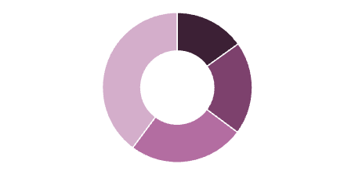
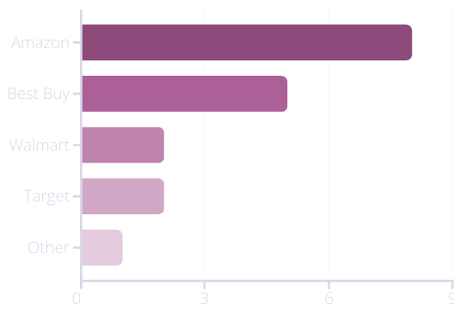
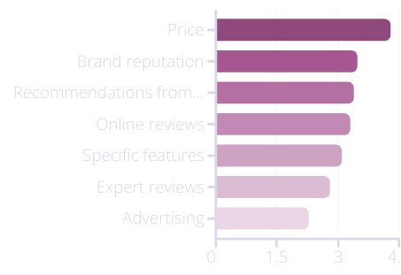
What Do Consumers Want: Price vs. Purchase Channel
Amazon dominates across all price brackets, especially in the $50–$150 range — reflecting convenience and competitive pricing.
Best Buy is the second most popular, favored by moderate spenders seeking in-person shopping.
Walmart and Target attract low to mid-budget consumers, signaling price sensitivity.
Brand websites lag behind, suggesting a need to improve online D2C pricing or incentives.
Consumers see Beats as overpriced — especially when competitors like JBL and Anker offer solid value within the $50–$150 bracket.
Launching a "Beats Lite" or budget line on Amazon could capture this value-conscious segment.
$200+
$150-200
$100-150
$50-100

Slide 6
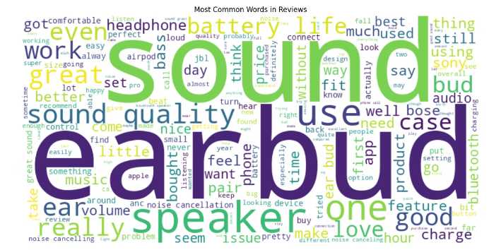
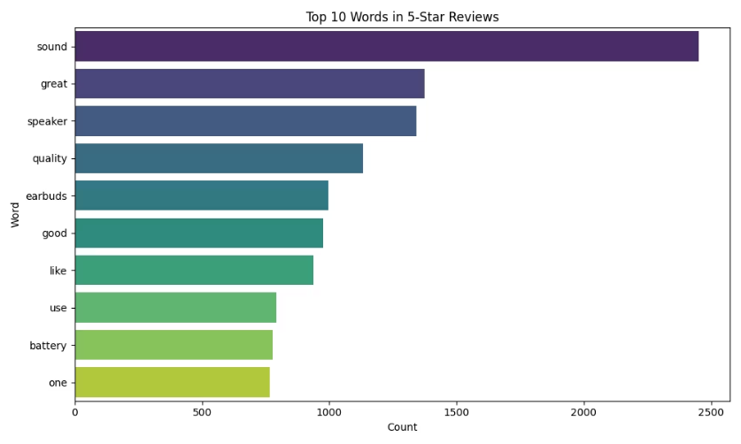
Top Features Praised by Customers
Sound quality: Frequently praised across all brands.
Design: Sleek and compact design noted positively, especially for Beats and Bose.
Ease of use: Users appreciated intuitive controls and setup.
Portability: Highly valued by JBL and Sony customers.
Brand loyalty: Mentioned by long-time users of Bose and JBL
Users value intuitive controls, voice assistant integration, and rugged durability.
.

Slide 7
Key Issues Raised by Customers
Battery complaints: Shorter-than-expected battery life, especially with ANC
Connectivity issues: Frequent Bluetooth disconnections across brands
Durability concerns: Fragile builds and scratched casings, especially in lower-priced models
Price concerns: Beats perceived as overpriced vs. JBL/Anker
Insight: Consumers expect speakers to be tough, affordable, and long-lasting — image alone isn’t enough.

Slide 8
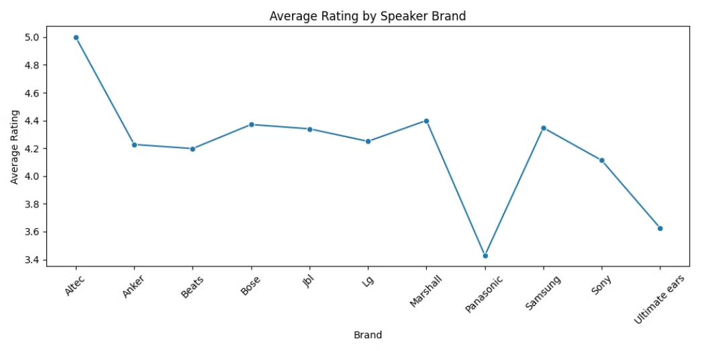
Brand Comparison Insights
Competitors like JBL and Bose praised for value and durability
Beats is viewed as stylish but premium-priced
Opportunity to differentiate with competitive pricing or added value features
Beats is praised for style and bass but criticized for battery life.
JBL wins on value, battery longevity, and portability.
Sony is noted for rich sound, but faces Bluetooth connectivity issues like Beats.
Consumers don’t just want “cool”—they want “capable and reliable”.

Slide 9
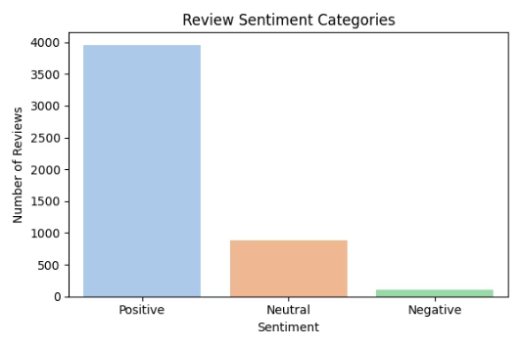
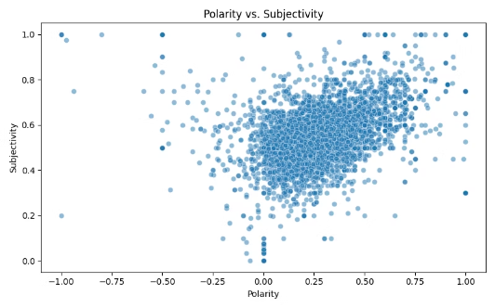
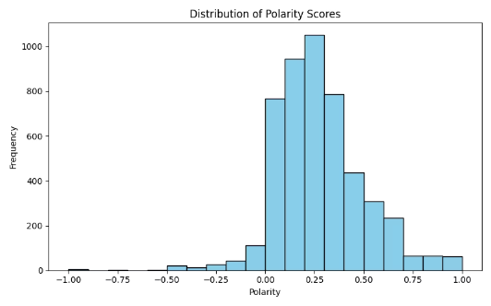
Sentiment Analysis Results (TextBlob & Gemini)
70% Positive, 22% Neutral, 7% Negative (TextBlob)
🔹 Sentiment Category Count Most reviews are positive, confirming strong brand perception. Neutral and negative reviews are fewer but highlight common product issues like battery life and durability.
Top positive drivers: "sound," "bass," "quality," "design"
Negative mentions: "battery," "disconnect," "fragile"
Insight: Beats has a strong emotional appeal but must improve reliability to compete.
🔹 Sentiment Polarity Histogram Reviews cluster toward the positive side, but there's a tail of dissatisfaction. Addressing core complaints could shift more users into the loyal category.
🔹 Polarity vs. Subjectivity Even negative reviews often include objective, actionable feedback — not just emotional opinions. Useful for guiding real product improvements.

Slide 10
Gemini AI Feature Sentiment Breakdown
Feature
Bose
Sony
Beats
Sound Quality
Mixed
Good Bass
Excellent Bass
Battery
Weak w/ ANC
Varies by model
Unreliable
Durability
Reliability Issues
Occasional faults
Frequent issues
Comfort
Small ears fit
Compact + light
Workout friendly
Noise Cancel
Strong
Moderate
Good/Okay
Takeaway: Competitors win on reliability. Beats wins on emotional pull.

Slide 11
Final Strategic Recommendations
Prioritize battery optimization for next Beats wireless speaker.
Market premium sound + long battery as differentiators.
Fix core issues: Battery life, durability, waterproofing, connectivity Issues
Assistant integration
Launch ruggedized mid-tier model: "Beats Go" or "Beats Core"
Introduce a budget-friendly "Beats Lite"
Bundle Beats with Apple ecosystem features
Improve packaging and user setup
Use influencer partnerships to reach Gen Z & Millennial markets
Emphasize lifestyle and identity in urban/fitness scenarios
Slogan Concept: "Built to Play. Styled to Win."

Slide 12
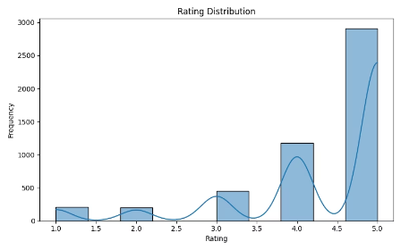
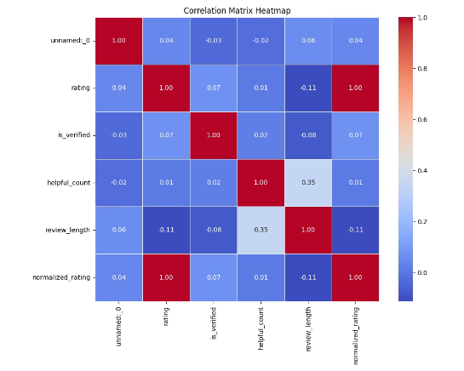
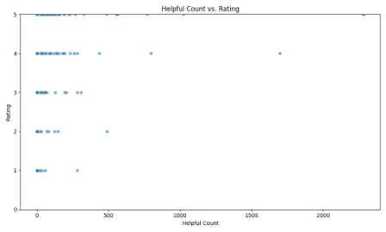
Slide 11: Appendix / Data Highlights
Scatter: Helpful votes vs. rating (outliers = credibility)
🔹 Rating Distribution (Histogram) Most reviews are 4–5 stars, but notable spikes at 3 and 1 stars show friction. Confirms high satisfaction overall, but recurring issues are impacting consistency.
Review distribution by top reviewers
Full list of top words, polarity trends
Survey respondent demographics + score weights
🔹 Correlation Matrix Longer reviews tend to be more helpful; ratings are largely independent of length or verification. This validates your focus on detailed reviews as the best source of insights.
🔹 Helpful Votes vs. Rating (Scatter Plot) Both high and low-rated reviews receive high helpfulness scores — especially detailed critical ones. This supports using negative reviews to guide product improvements and strategy.

